Slide 1
PSCustomObjects vs Hashtables
Anthony Howell
ThePoShWolf
1 / 15

Slide 2
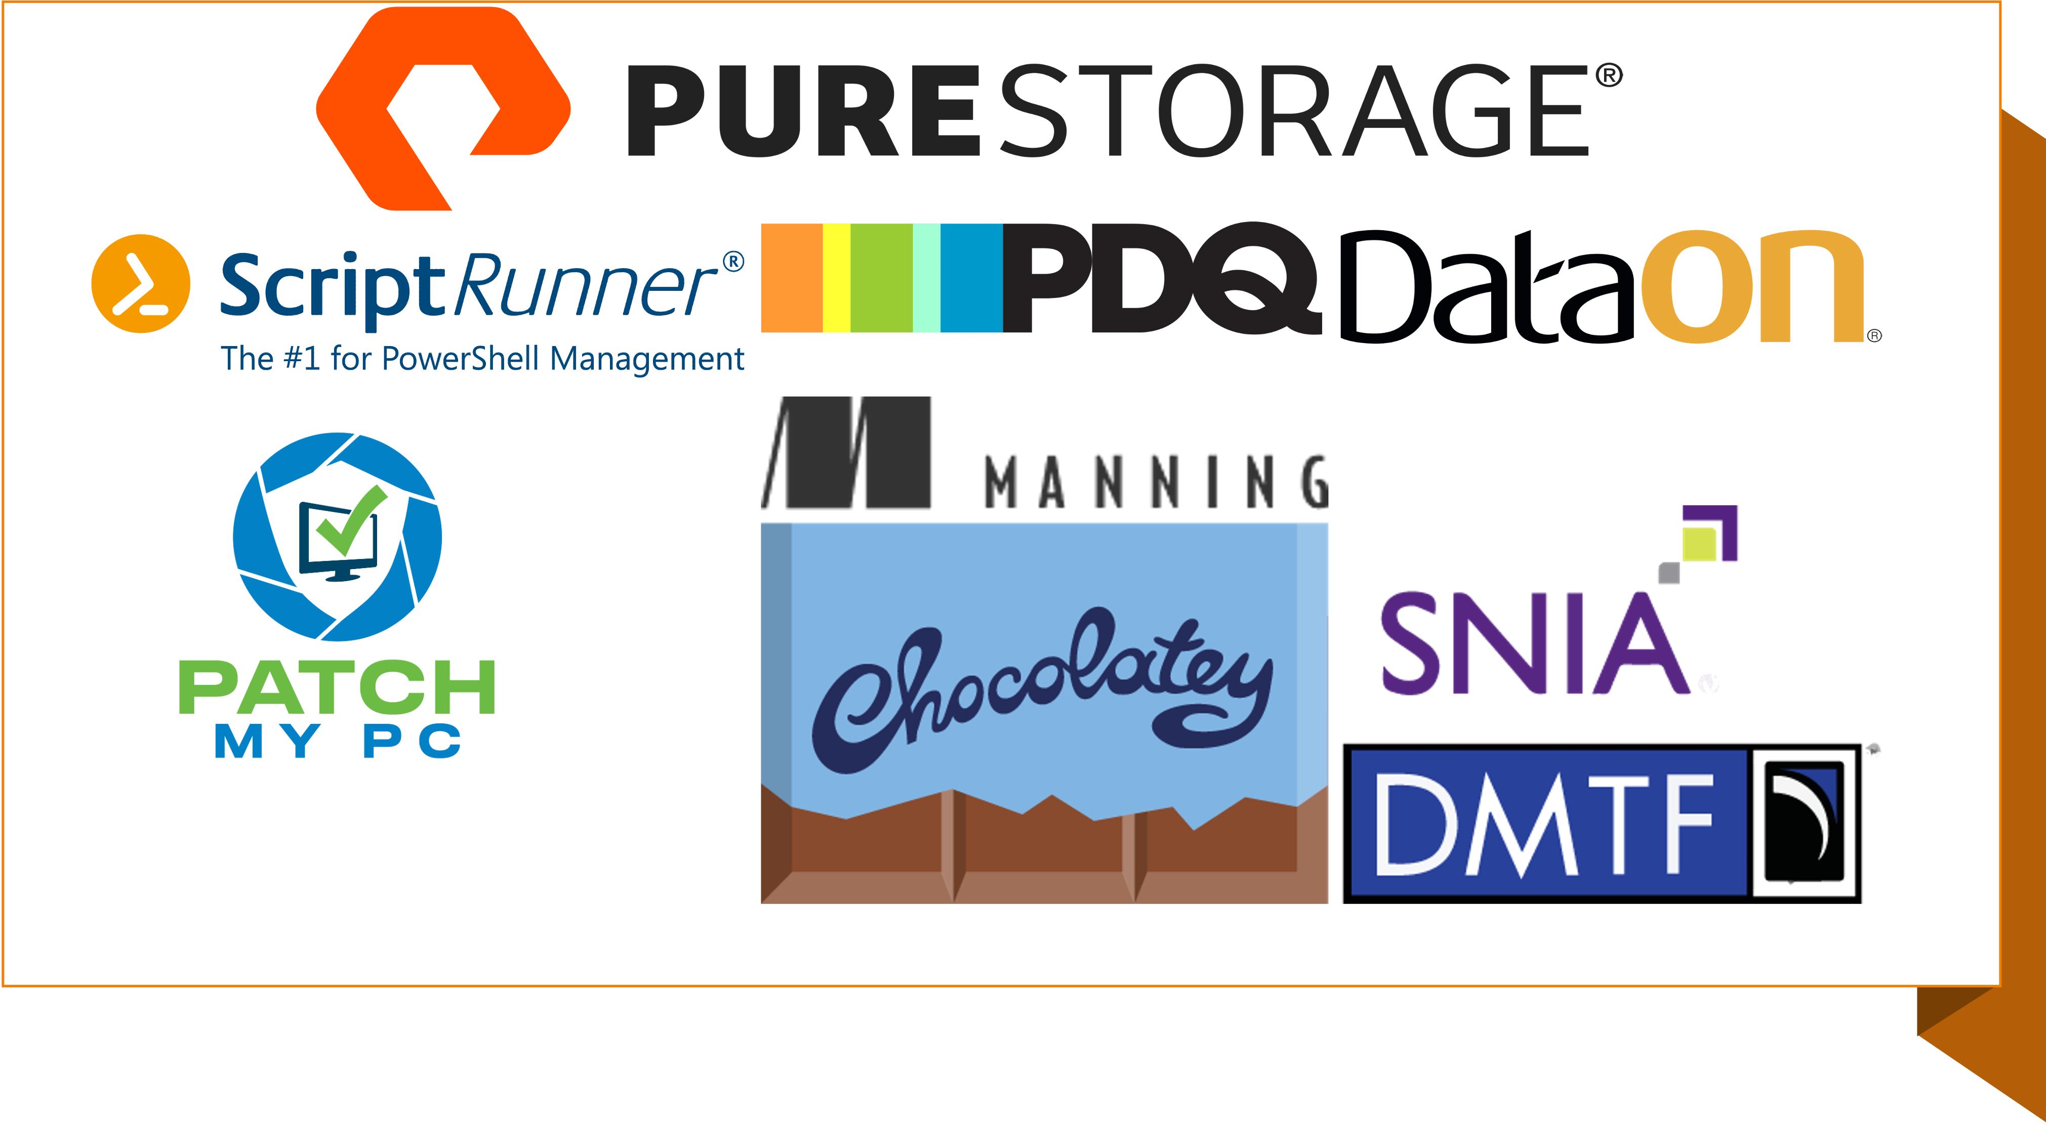

Slide 3
github.com/theposhwolf/sessions

Slide 4


Who am I?
Anthony Howell
From Eugene, OR USA
Yes, its probably raining
4 kids, 2 dogs, 1 wife
My wife is very busy this week!
‘Choose your own adventure’ style IT career
Director of DevOps @ Evolent
Notes:
Helpdesk, call center, field tech, desktop support, sysadmin, devops engineer, PowerShell engineer, SRE, sales engineer, cloud architect, director

Slide 5

Picture

Slide 6

Overview
Quick refresh: What are they?
In depth look:
Create
Update
Output
Iterate
When to use one over the other
Case study

Slide 7

Prerequisites
PowerShell (5.1+)
Demo is done with:
PowerShell 7.4.1
VS Code latest
Windows 10

Slide 8
PSCustomObject
help about_pscustomobject
Type accelerator to create PSObjects
help about_type_accelerators
Type accelerator is an alias for a .NET type
Casting for a hashtable
[pscustomobject]@{key=‘value’}
[pscustomobject]@{
Event = 'DevOps Summit 2024'
Date = '2024-04-10'
Location = 'Bellevue, WA'
}

Slide 9
Hash tables
help about_hash_tables
Dictionary or ‘Associative Array’
A collection of key/value pairs
@{key = ‘value’}
Keys and values can be any .NET type
‘very efficient for finding and retrieving data’
@{
Event = 'DevOps Summit 2024'
Date = '2024-04-10'
Location = 'Bellevue, WA'
}

Slide 10

Demo

Slide 11
Moral of the demo
Use hash tables for
Performance
Use PSCustomObjects for
Presentation

Slide 12

Questions

Slide 13

THANK YOU
Please review this session

